Slide 1

TEAM 5 PROJECT
STARK INSURANCE DATA-MINING PROJECT
MSIS 5633

Slide 2
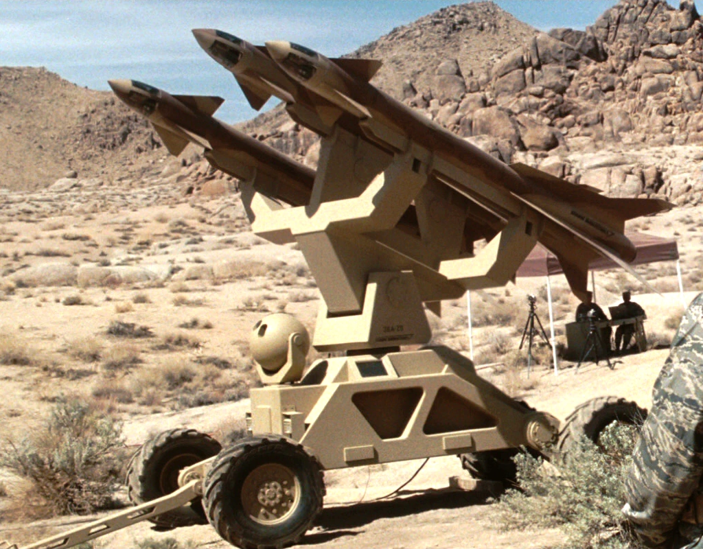



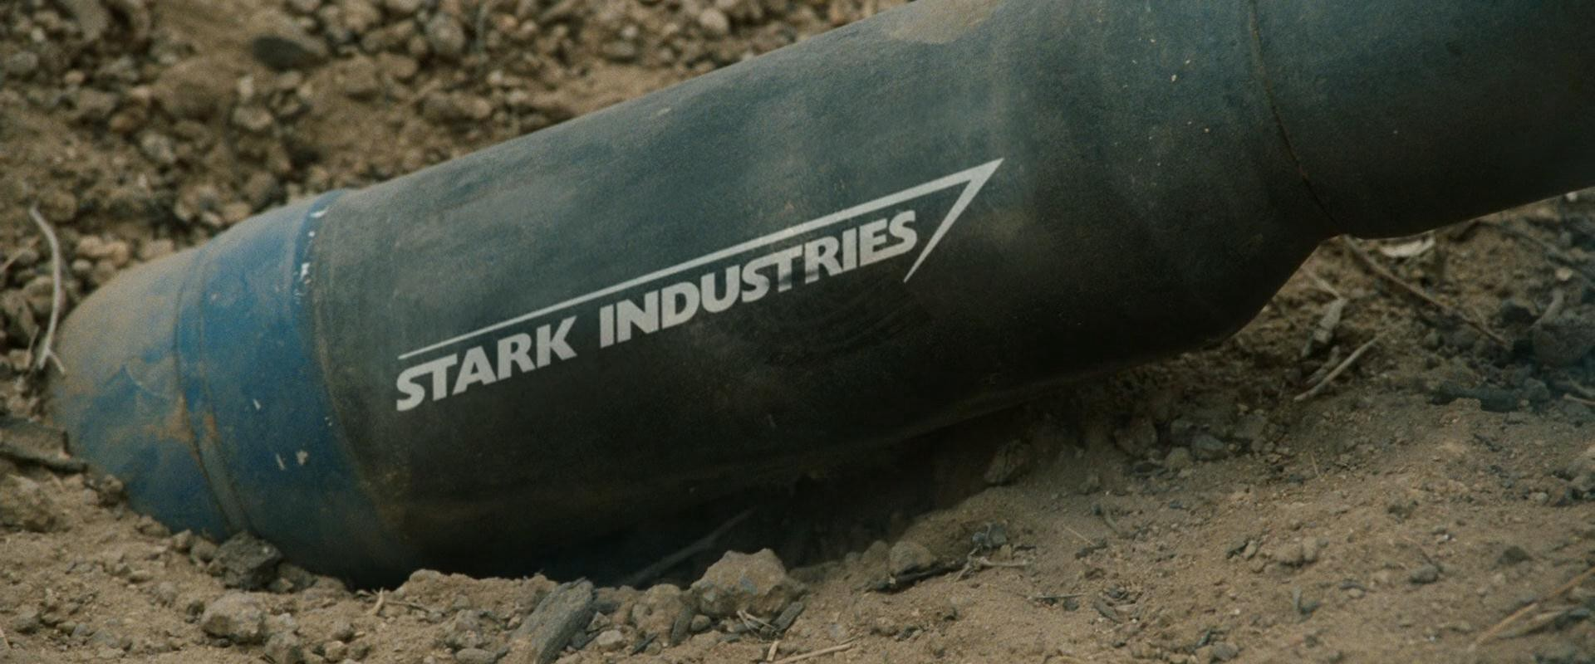
Business Understanding

Slide 3


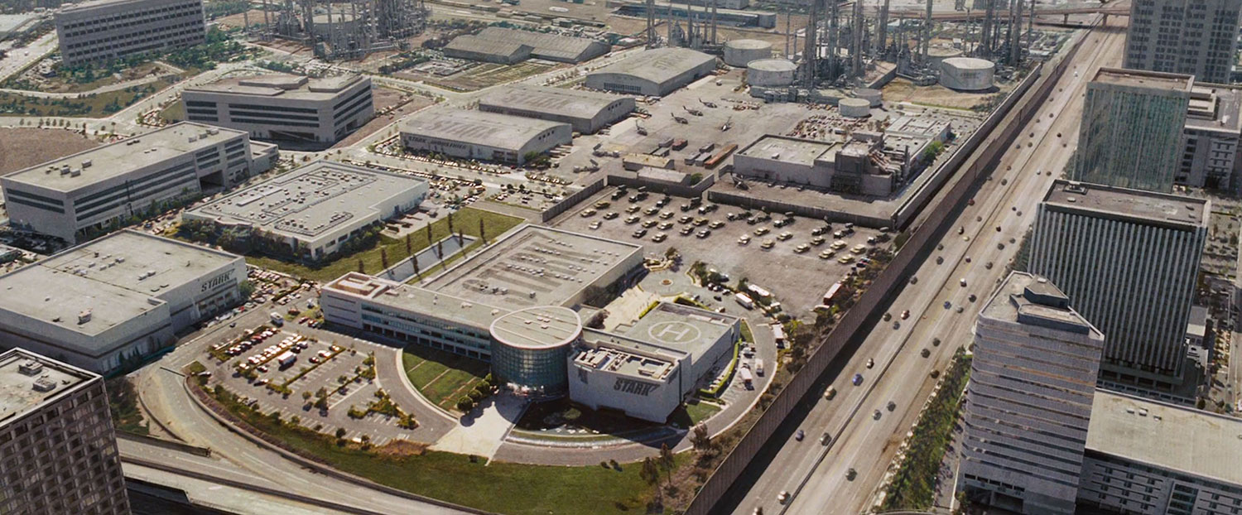
STARK INSURANCE
Subsidiary of STARK INDUSTRIES
Provide Plans in 47/50 States
Insure over 15 million Americans
Constantly looking for ways to reduce risk
Provide a safety net for their customers for damages to vehicles and medical expenses
Looking into predictive analytics as a cost cutting/revenue generation measure
Headquarters: 52 Discovery Dr, Irvine CA 92618

Slide 4
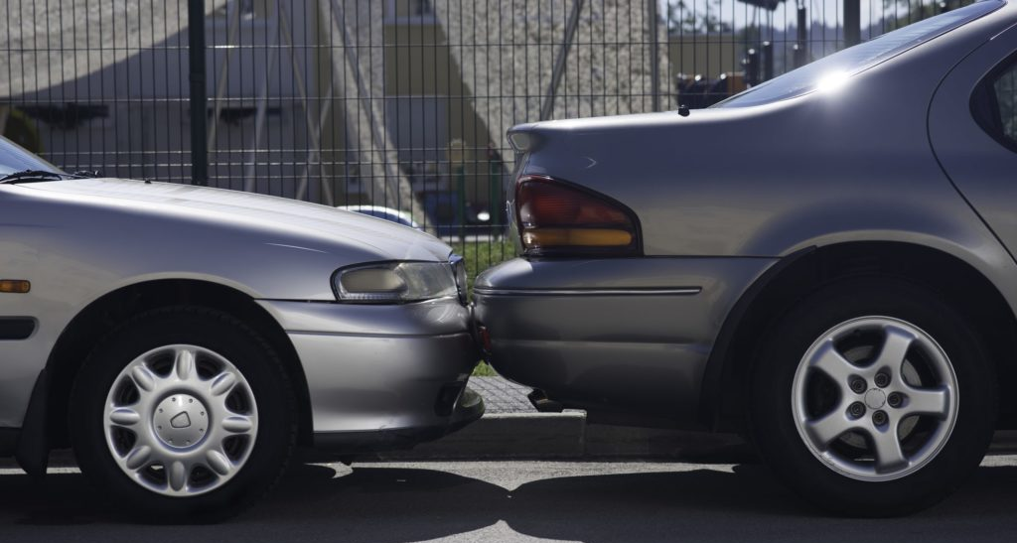
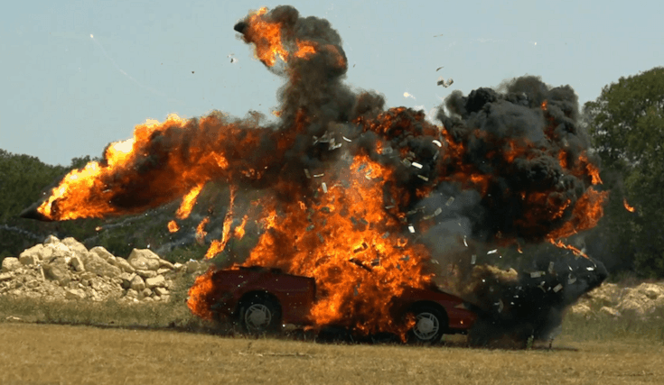
Purpose
Use Crash Report sampling System data to predict
Crash injury severity current policy holders
Crash injury severity in application process for insurance
Provide value to Stakeholders
Increase Revenue for shareholders
Reduce costs for company
Improve relations with medical community
Lower costs for some clients

Slide 5



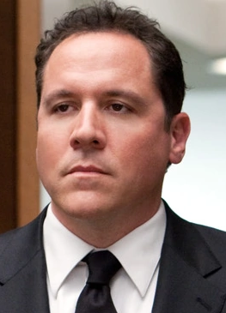

Project Team
Project owner: CEO, Tony Stark
Risk Profiling Expert: Director of Risk, Pepper
Car Insurance SME: Director of Customer Service Happy
Application Development: CIO, Peter Parker
Data-Mining: Data-Mining Team
Data-Mining Team
Tony Stark
Pepper Potts
Happy
Peter Parker

Slide 6





DATA-MINING TEAM
Kyle McCulloch
Joshua Meyer
Showrav Rifayat
Jeremiah Hamilton
Kyle
Jeremiah
Showrav
Joshua

Slide 7
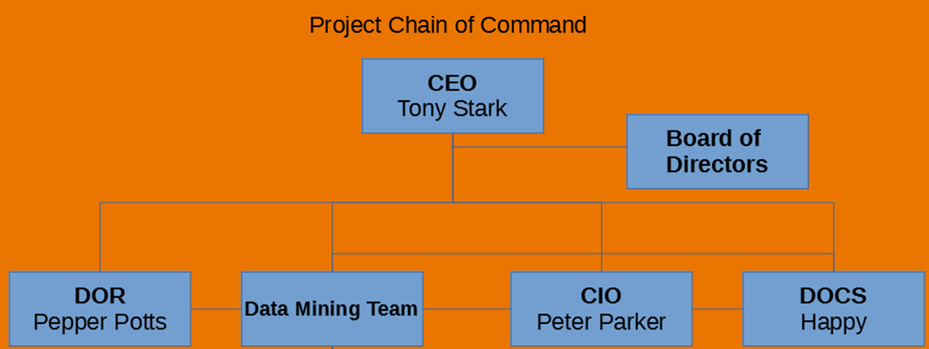

Slide 8
Evaluation Criteria
Criteria | Minimum Threshold | Intermediate Threshold | Ideal Threshold | Weight (Relative Importance)
Accuracy | 80%< | 85%< | 90%< | .5
Sensitivity | 50%< | 60%< | 70%< | .2
Specificity | Not Required | 60%< | 70%< | .1
Explanatory Power | Black Box | Some Explanatory Power | Fully Transparent | .2

Slide 9
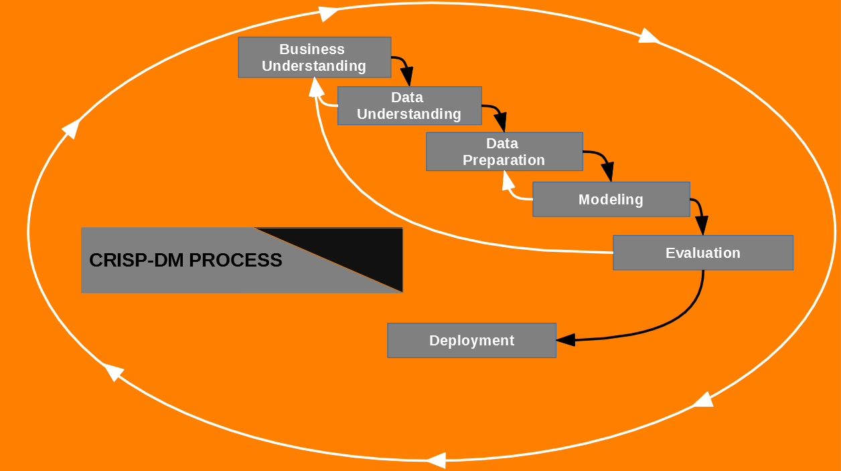
Project Methodology

Slide 10
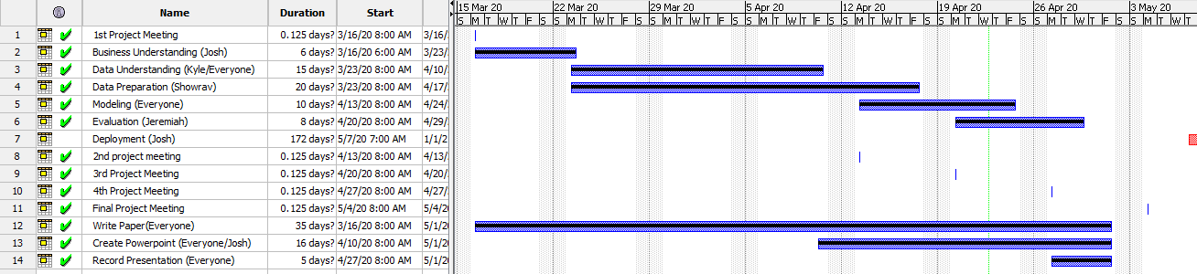

Slide 11


Slide 12
Data Understanding
Data is divided into 4 tables:
The Accident table provided data based on the accident. The primary key for this table is CASENUM and is the primary identifier for accidents.
The Vehicle table provides data based on the individual vehicle involved in the accident. The CASENUM variable links this record to the accident table. VEH_NO identifies which vehicle in the accident this record identifies.
The Person table identifies each individual in the accident. Each record has a CASENUM to link it to an accident, a VEH_NO to link to the vehicle involved, and PER_NO uniquely identifies the person in the vehicle.
The Distract table identifies if the driver of the vehicle was distracted. The CASENUM, VEH_NO, and MDRDSTRD are the unique Identifiers for this table. Our team did not find any value in using this table.

Slide 13
Variable Selection Goals
The goal of our team was to select variables that were known to the insurance underwriters at the point of determining premium pricing.
This would only include pre-collision data. As well as data collected from previous accidents to help the underwriters to determine which vehicles have a history of accidents involving high severity injuries.

Slide 14
Variable Selection
REGION - This variable describes the region of the United States that the accident was involved in.
URBANICITY – If the population is less than 250,000 it is considered urban, greater than 250,000 is city.
SEX – Identifies the gender of the person
AGE – Identifies the age of the person
MAKE – The manufacture of the vehicle the customer is looking to ensure
MODEL – The model of the vehicle.
MOD_YEAR – the year the vehicle was made.
GVWR – Categorical variable that identifies what weight class the vehicle belongs to.

Slide 15
Variable Selection
ROLLOVER – Categorical variable that describes if the vehicle experienced 90 degrees or more of rotation. We included this variable because some vehicles like SUVs are more susceptible to rollovers than others.
IMPACT1 – This variable describes the area of the vehicle that resulted in the first instance of injury.
DEFORMED – This is a categorical variable that describes how badly damaged the vehicle is after the accident. It rates from no damage to disabling damage.
FIRE_EXP – This variable indicates if there was a fire from the result of the accident. We chose this variable to try and identify vehicles with a high fire risk like the Ford Pinto.
SPEEDREL – This is a categorical variable that explains if the accident was the result of speeding or not.
P_CRASH2 – This variable describes the event that lead to the crash. This variable identifies what the vehicle was doing just prior to the accident and what made the vehicle’s situation critical.

Slide 16
Variable Selection
ACC_TYPE – This describes the type of accident involved.
SEAT_POS – Identifies where in the vehicle the person was located. We used this information to identify areas in the vehicle that are the most dangerous.
REST_USE – Binary variable that describes if a restraining system like a seat belt was used.
EJECTION – Used to identify if the person involved was ejected from the vehicle due to the accident.
AIR_BAG – Identifies if an airbag was deployed and what type was used. We chose this variable to determine if vehicles with multiple airbags are safer than just one.
ALCH_TRANS – Derived variable that indicates if the driver was under the influence of alcohol at the time of the accident.
DRUGS_TRANS – Derived variable that indicates if the driver was under the influence of drugs at the time of the accident.

Slide 17
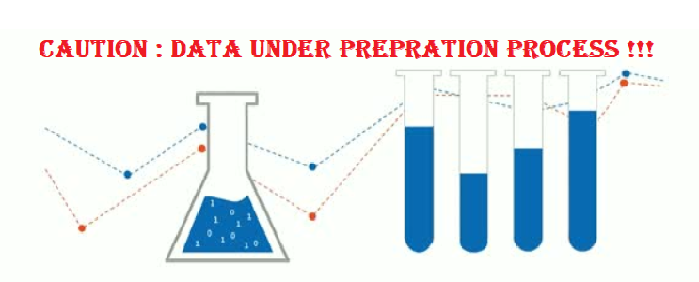

Slide 18
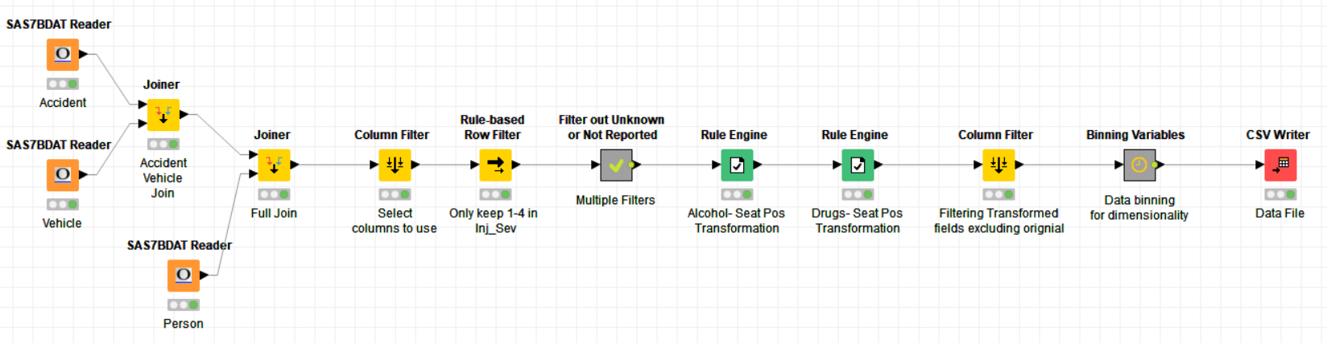
Data Preparation
What is Data Preparation?
The Key goal is to eliminate noisy data
Also it is best to prepare/transform the data depending on predictive models that will be evaluated
How did we handle the data? The following four steps:
Data Filtering
Rule Engine (Transformation)
Rule Engine (Data Binning)
Model Preparation

Slide 19
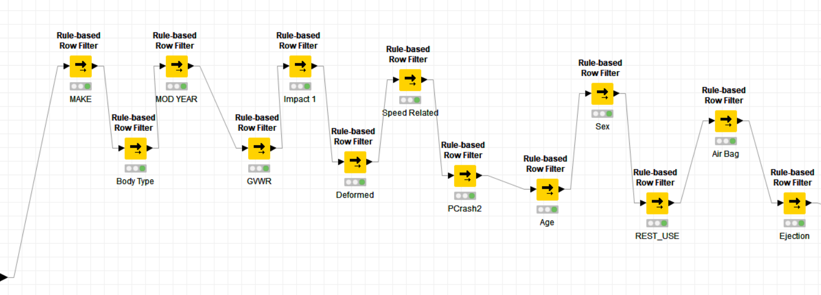
Data Filtering
What was done in this step?
The primary goal was to eliminate unnecessary/noisy data from the model
How was it done?
Eliminating classes in the variables that were identified per the data catalog Unknown or not reported
Variables impacted
Make, Body Type, Vehicle Model Year, Gross vehicle weight rating, Area of impact – initial contact point, Deformed, Speed related, Critical event- pre crash, Age, Sex, Restraint system/helmet use, Air bag deployed, and Ejection

Slide 20
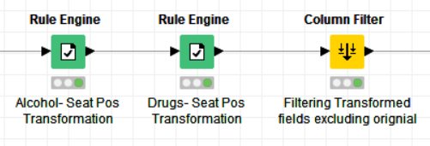
Rule Engine (Transformation)
What was done in this step?
Transforming variables to avoid any unwanted results in modeling.
How was it done?
Rule engine (if-then rules) applied on relevant variables
The Drugs and Alcohol variables (i.e if drugs or alcohol was in use during accident) were limited to just seat position 11 (i.e. the driver). This was done to avoid any duplicate counts in a vehicle for use of drugs or alcohol.
Eliminated original variables and kept newly transformed variables
Variables impacted
Drugs and Alcohol. New variable Drugs_trans and Alcohol_trans

Slide 21
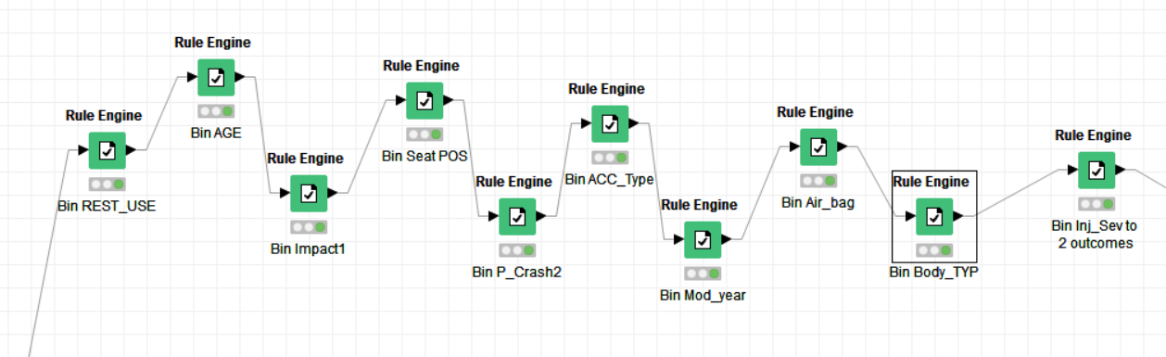
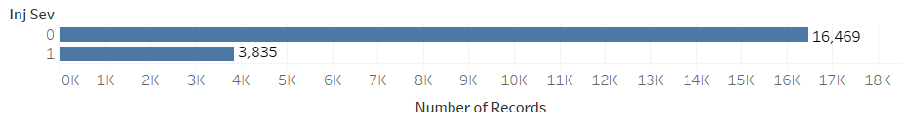
Rule Engine (Data Binning)
What was done in this step?
Resolved dimensionality issue, as most of the nominal variables had to many class variables.
How was it done?
Rule engine (if-then rules) applied on relevant variables
Multiple nominal variables, as seen in screenshot below
Rules applied per the data profile. For example, the Seat Position had four separate buckets for the front, back, cargo, etc. seats and these were binned to one bucket (i.e. front seat, back seat, etc.)
The dependent variable injury severity was changed to binary. Class 1 and 2 classified as 0 (low severity) and Class 3 and 4 as 1 (high severity)
Variables impacted
See screensot below. New variables have _bin at the end

Slide 22
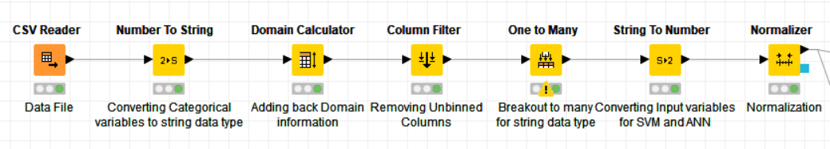
Model Preparation
What was done in this step?
Prepare Variables for multiple predictive model types (string loving vs number loving)
How was it done?
CSV file of data file used to first convert all variables to string, as they are all categorical data types
Use a domain calculator as filtering as done in our prior steps can cause domain information to get lost
Removed all original columns for data that went through the data binning step (note: this is the final step to start the string loving models)
One to many step to break out each class for all the nominal input variables
Convert all to string input variables to numbers
Normalize by putting making sure all input variables are are between 0 and 1 (note: this is the final step to start the number loving models)

